Slide 1

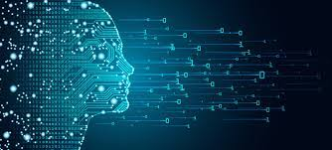
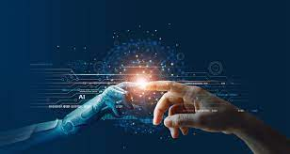
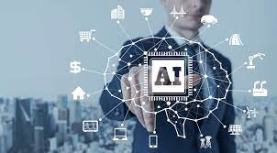

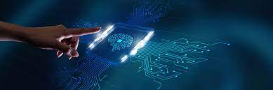
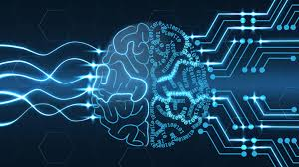
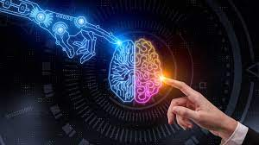
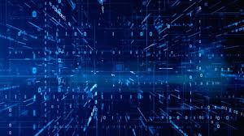
AI and ds project
TEAM MEMBERS:​
S.J SUMANTH(2010030377)​
K. SREEVARUN(200030451)​
E. PAVAN SAI(2010030538)​
E. SHIVA GOUD(2010030542)​

Slide 2

OUTLINE :
Introduction and Problem context
Literature Review
Problem in existing system
Objectives
Implementation Steps
Methodology
Conclusion

Slide 3
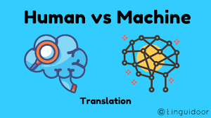
INTRODUCTION
And
Problem context
Machine translation : Machine Translation has been
defined as the process that utilizes computer software to
translate text from one natural language(such as English)
to another (such as Arabic).
Natural language processing (NLP) is the ability of a
computer program to understand human language as it is
spoken and written- referred to as natural language. It is
a component of artificial intelligence
A translator must interpret and analyze all of the elements in the text and know how each word may influence another. This requires extensive expertise in grammar, syntax (sentence structure), semantics (meanings), etc., in the source and target languages, as well as familiarity with each local region.

Slide 4
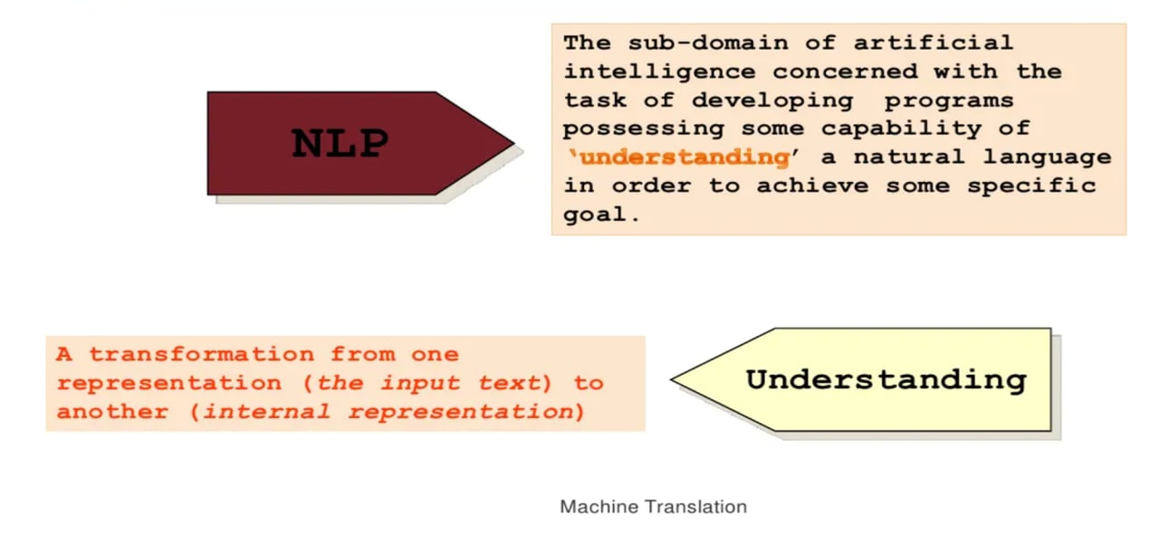

Slide 5
LITERATURE REVIEW
S.No | Title | Author | Journal and Year | Model Used | Accuracy | Scope
1. | Neural Machine Translation of Indian Languages | Karthik Revanuru, Kaushik Turlapaty, Shrisha Rao | ACM Journals - 2017 | Encoder and Decoder Model | For Urdu-Hindi, Punjabi-Hindi and Gujarati-Hindi Translations, this model outperformed Google translate. | They want to extend this to a real time speech to speech translation
2 | Neural Machine Translation of Text from Non-Native Speakers | Antonios Anastasopoulos, Alison Lui, Toan Nguyen, David Chiang | arXiv Journal -2019 | LSTM models, R-Transformer model | Even though the sentence has grammatical errors the results obtained with the transformer Model are consistently better than the LSTM one. | They produced Spanish translations of the JFLEG corpus, so that future NMT systems can be properly evaluated on real noisy data.

Slide 6
LITERATURE REVIEW
S.No | Title | Author | Journal and Year | Model Used | Accuracy | Scope
3 | Multilingual Neural Machine Translation for Low-Resource Languages | Surafel M. Lakew, Marcello Federico, Matteo Negri, Marco Turchi | Italian Journal of Computational Linguistics -2018 | Encoder and decoder models, RNN Models | The multilingual NMT can help to tackle the challenges associated with translating low-resourced languages such as Urdu. | They plan to explore this approach across language varieties using a multilingual model.
4 | Neural Machine Translation for Harmonized System Codes prediction | Xi Chen, Stefano Bromuri, Marko Van Eekelen | ACM Journals -2018 | HLR, LSTM, LSTM with hierarchical loss (LSTM-HL), NMT and NMT with hierarchical loss (NMT-HL) | If no limitation (N.A) is imposed, HLR has the best performance among all models. | on the business side, the architecture will be extended to predict more than six digits which might have different output length.

Slide 7
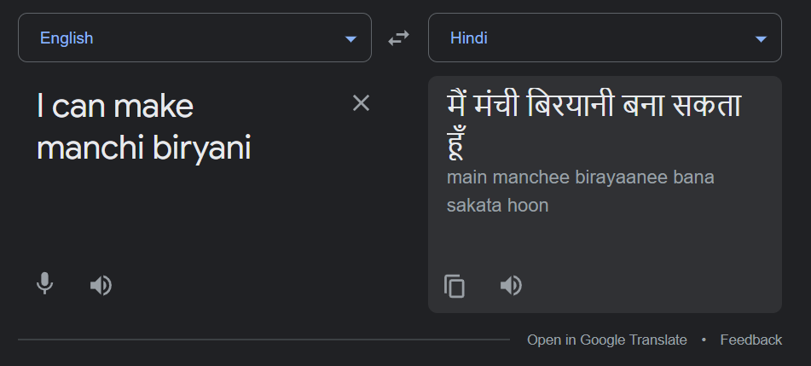








Problems in existing system
Most translators that we find on web are used to translate one language to another, then what if a person speaks a bilingual conversation…? It translates one language and leaves the unrecognized words unchanged.
This problem occurs while translating a real-time conversation as we use words of different languages when we speak.

Slide 8

CODE-MIXING Translation

Slide 9



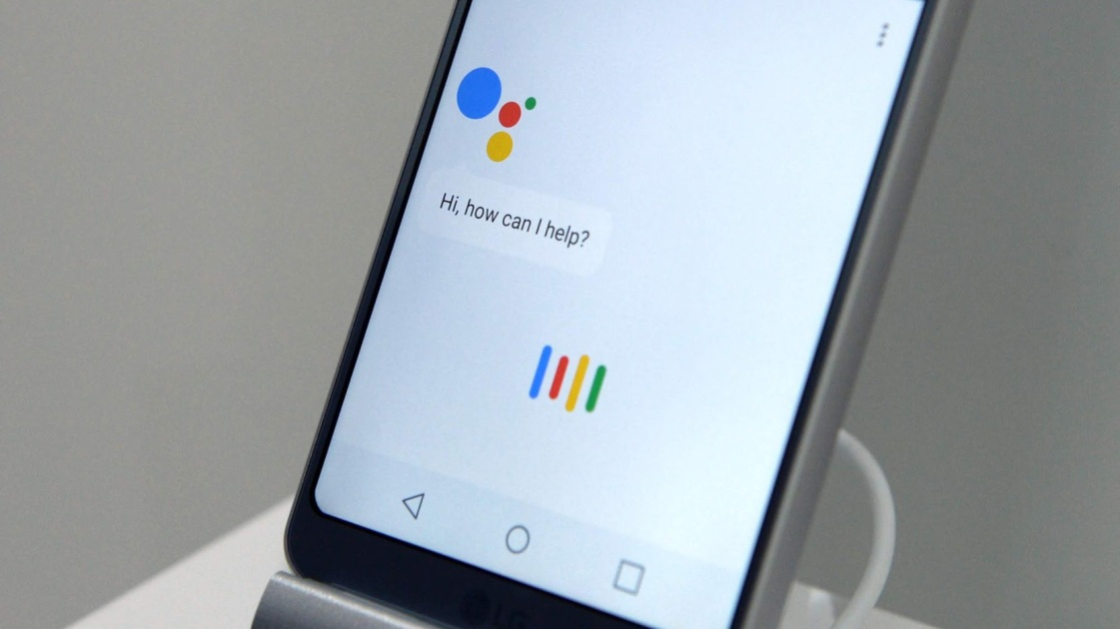



1.Our main objective is to implement mixed language translation.
I will make మంచి cake
मैं मांची केक बनाऊंगा

Slide 10

Implementation steps:
Step - 1:
INPUT:
The user needs to give input through microphone in the form of audio or the user can give the input in the form of text.
If the user gives the input in the form of audio, the pyaudio package will analyze/detect the speech.
Working of pyaudio:
PyAudio provides Python bindings for PortAudio, the cross-platform
audio I/O library. With PyAudio, we can easily use Python to play and
record audio on a variety of platforms.

Slide 11
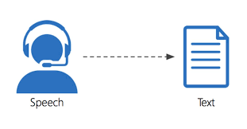
Step – 2:
Convert the audio into text by using SpeechRecognition API.
Working SpeechRecognition API:
Speech recognition software works by breaking down the audio of a speech recording into individual sounds, analyzing each sound, using algorithms to find the most probable word fit in that language, and transcribing those sounds into text.
A speech recognition algorithm or voice recognition algorithm is used in speech recognition technology to convert voice to text.

Slide 12
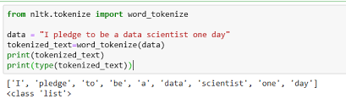
Step - 3:
The input received will be divided into tokens using word_tokenize() function.
The pycld2 package in python analyzes every token and calculates number of English words and non-English words.
Working of pycld2:
For detecting English and non-English words we are using one of the python packages pycld2.

Slide 13
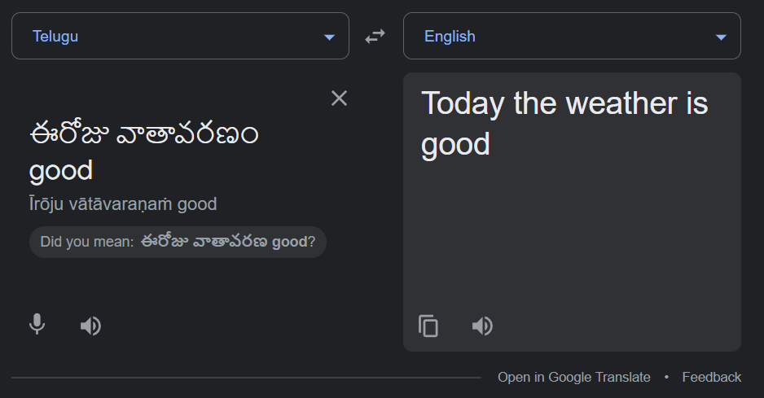
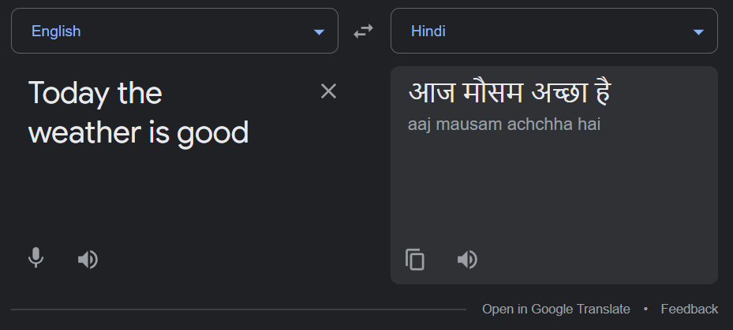
Step - 4:
If the sentence contains more Telugu words and less English words, then we convert complete sentence to English and then translate to Hindi.

Slide 14
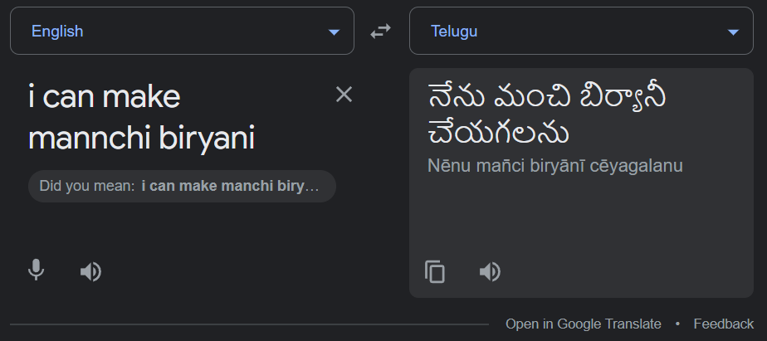
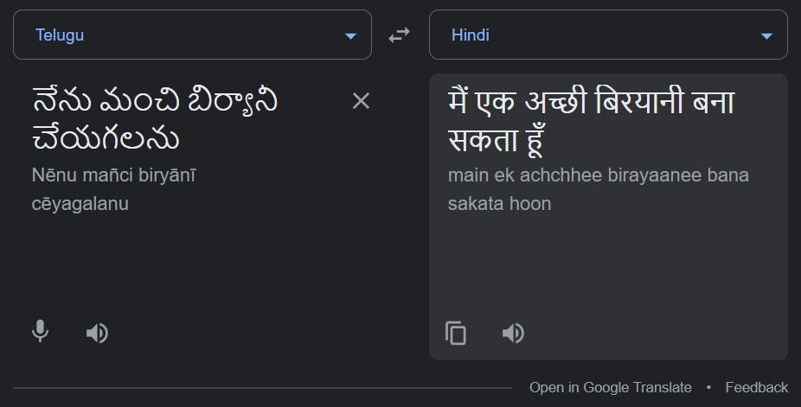
Step - 5:
If the sentence contains more English words and less Telugu words, then we convert complete sentence to Telugu and then translate to Hindi.

Slide 15
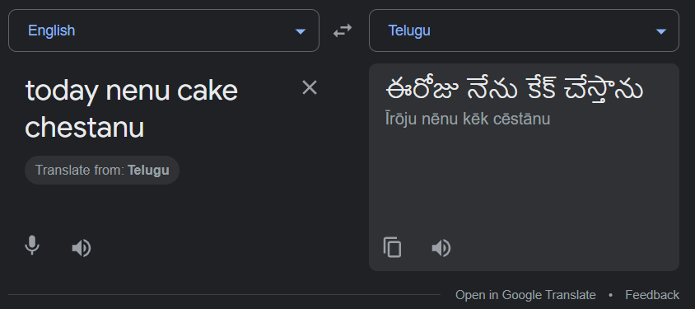
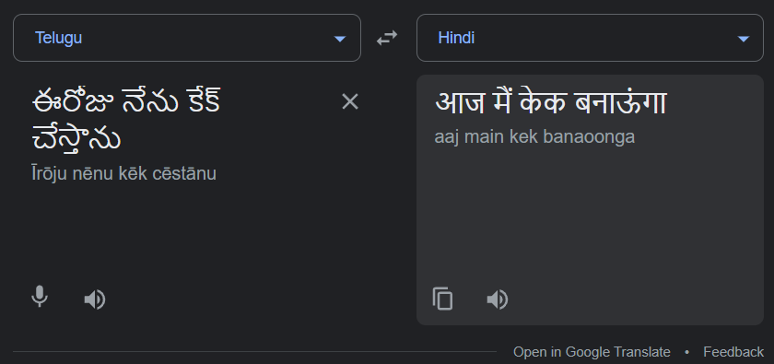


Step - 6:
If the sentence contains equal number of English, Telugu words, then we convert complete sentence to Telugu and then translate to Hindi.

Slide 16

Step - 7:
Output the translated sentence in the form of audio using gTTS API.
Working of gTTS API:
There are several APIs available to convert text to speech in Python. One of such APIs is the Google Text to Speech API commonly known as the gTTS API. gTTS is a very easy to use tool which converts the text entered, into audio which can be saved as a mp3 file.

Slide 17
Methodology
Data Preprocessing
Feature Engineering
Feature Selection
Model Deployment
Model Testing
Model Creation

Slide 18
CONCLUSION
In today’s world, Machine translation creates an ability to balance cost, quality, and time.
The field of machine translation has seen major changes in the last few years. Currently a large amount of research is being done into machine translation.
There is no bilingual translator till today , so we want develop our project in that perspective.

Slide 19


